Slide 1
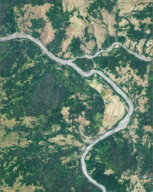
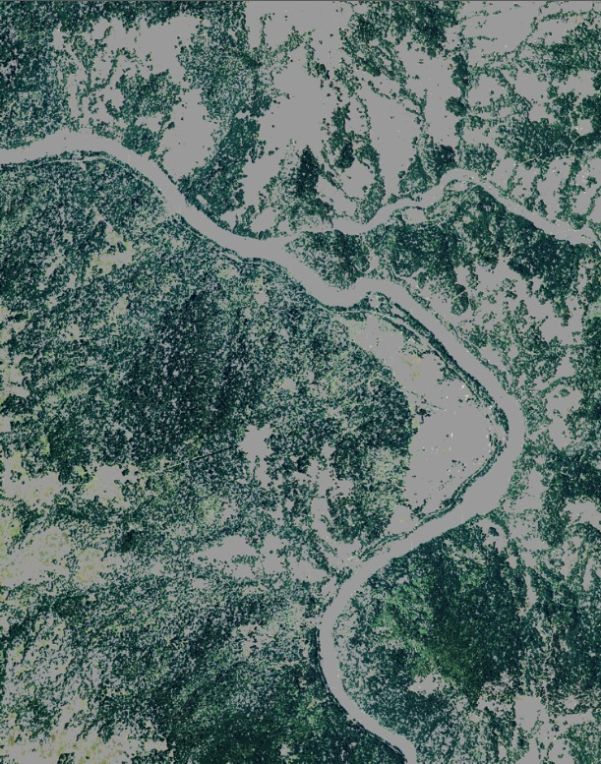
Reducing Uncertainties in Satellite-derived Forest Aboveground Biomass Estimates using a High Resolution Forest Cover Map
PI: Sangram Ganguly (BAERI/NASA ARC)
Co-I: Cristina Milesi, Ramakrishna Nemani (NASA ARC)
Research support: Saikat Basu (LSU), Gong Zhang (BAERI)
Collaborator: Bruce Cook (NASA GSFC)

Slide 2
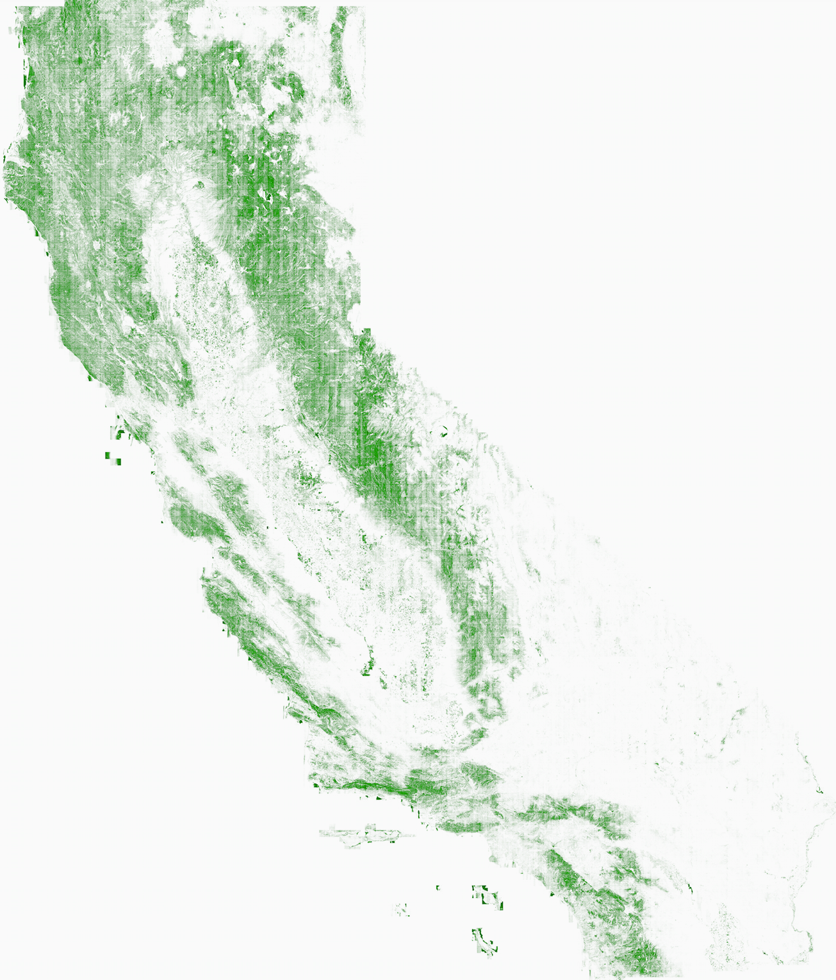
Objective 1 & Approach
Build 1-m CONUS estimates of tree cover based on NAIP 1-m color-infrared imagery from 2010 till 2012 Use NEX high-performance computing and rapid access storage facility for applying a scalable semi-automated segmentation/classification algorithm to thousands of scenes
California
1-m tree cover map
Notes:
300,000 image data files totaling a file size of ~65 Terabytes
Algorithm robust to variability in land cover and illumination conditions

Slide 3
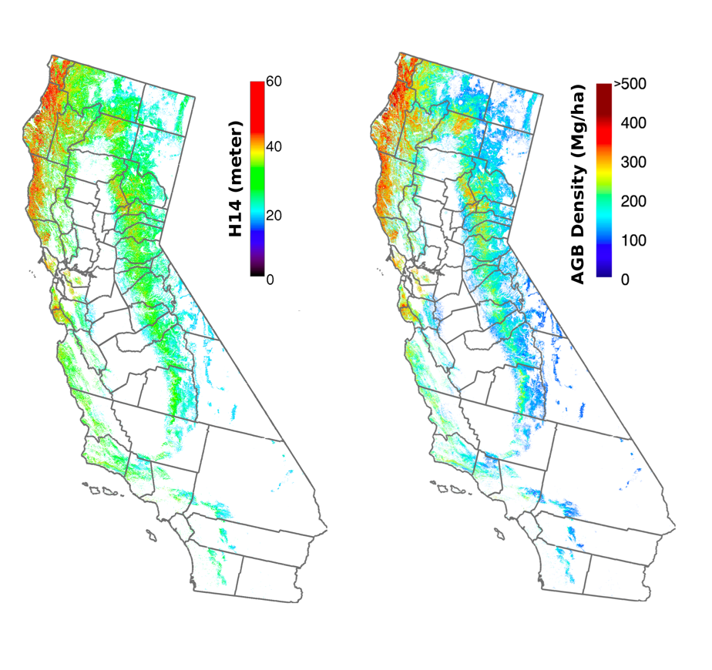
Objective 2 & Approach
Create improved 30-m forest aboveground biomass estimates over CONUS Apply a parametric model based on Landsat LAI, GLAS canopy height metrics and NAIP-derived percent tree cover map at 30-m

Slide 4
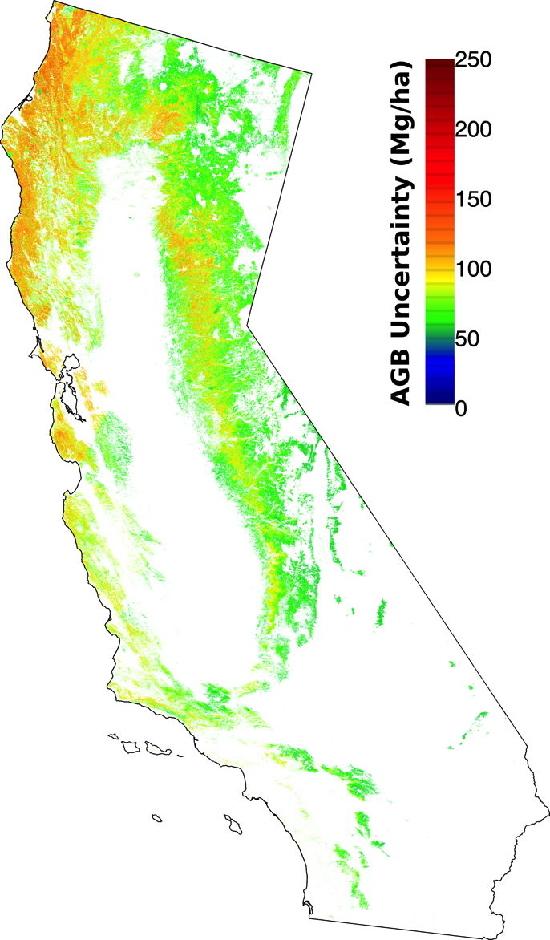
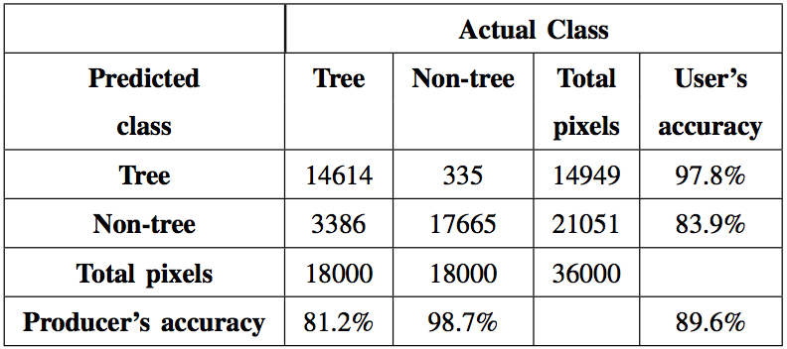
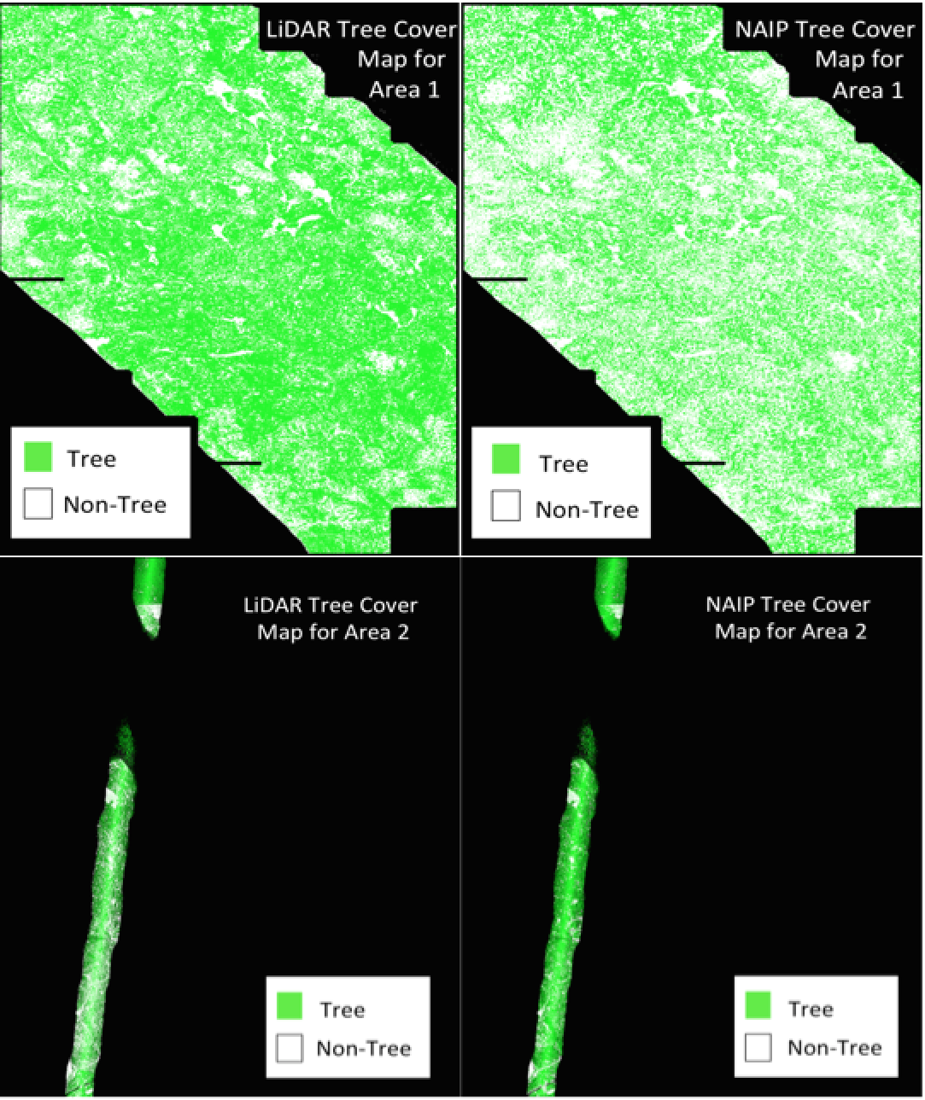
Objective 3 & Approach
Accuracy assessment and uncertainty characterization of NAIP tree cover and aboveground biomass estimates Error matrix analysis and airborne LiDAR tree cover, followed by Monte Carlo based error propagation of uncertainty into AGB estimates

